Slide 1
ABSENTEEISM

Slide 2
PROBLEM STATEMENT
Predicting absenteeism from work, means whether or not an employee can be expected to be missing for a specific number of hours in a given workday.
Having such information in advance can improve our decision making, by reorganising the work process in a way that will allow us to avoid a lack of productivity and increase the quality of work generated in our firm.

Slide 3
WHAT IS ABSENTEEISM?
Absence from work during normal working hour, resulting in temporary incapacity to execute regular working activity.
– So based on what information should we predict whether an employee is expected to be absent or not?
– How would we measure absenteeism?

Slide 4
PURPOSE OF THE BUSINESS EXERCISE
Explore whether a person presenting certain characteristics is expected to be away from work at some point in time or not.

Slide 5
SOME COMMON QUESTIONS TO BE CONSIDERED
How far they live from their workplace?
How many childrens and pets they have ?
Do they have higher education ?

Slide 6
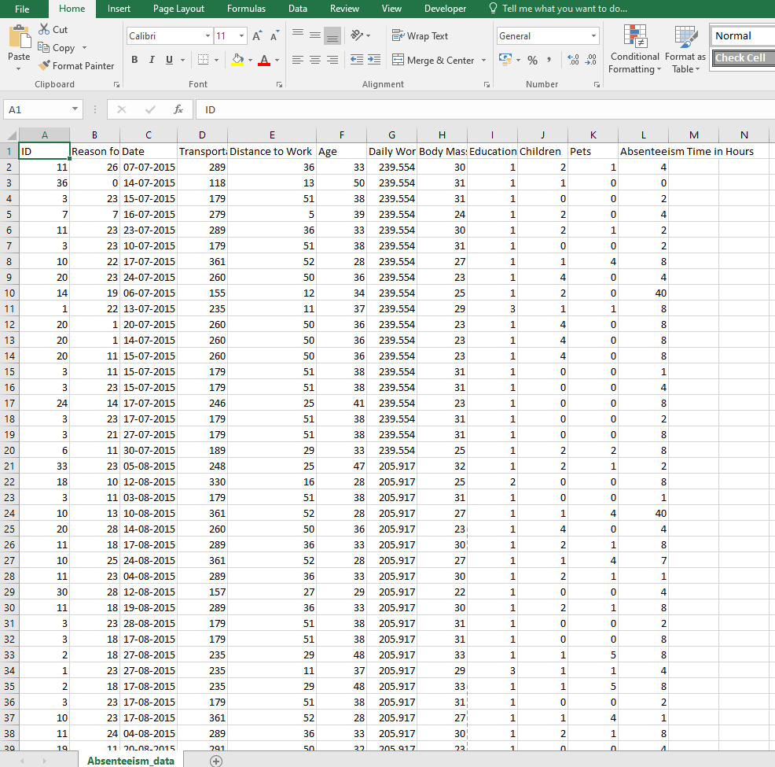
ABOUT THE DATA
DATA WE WILL BE WORKING IS SECONDARY DATA

Slide 7
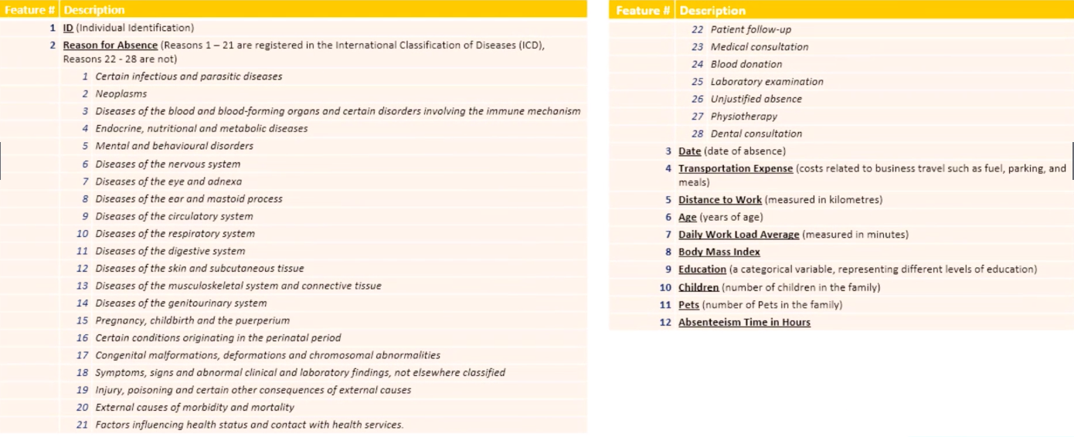

Slide 8
Reasons
1 to 14 → Reason 1
15 to 17 → Reason 2
18 to 21 → Reason 3
22 : -→ Reason 4

Slide 9
STEPS PERFORMING
ASK ,PREPARE, PROCESS, ANALYZE, SHARE,ACT
OR
COLLECTING AND ORGANISING DATA, DATA PREPROCESSING,DATA ANALYSIS, MODEL FITTING ,CONNECTING WITH SQL ,DATA VISUALIZATION , PRESENTING THE DATA AND STORY TELLING

Slide 10
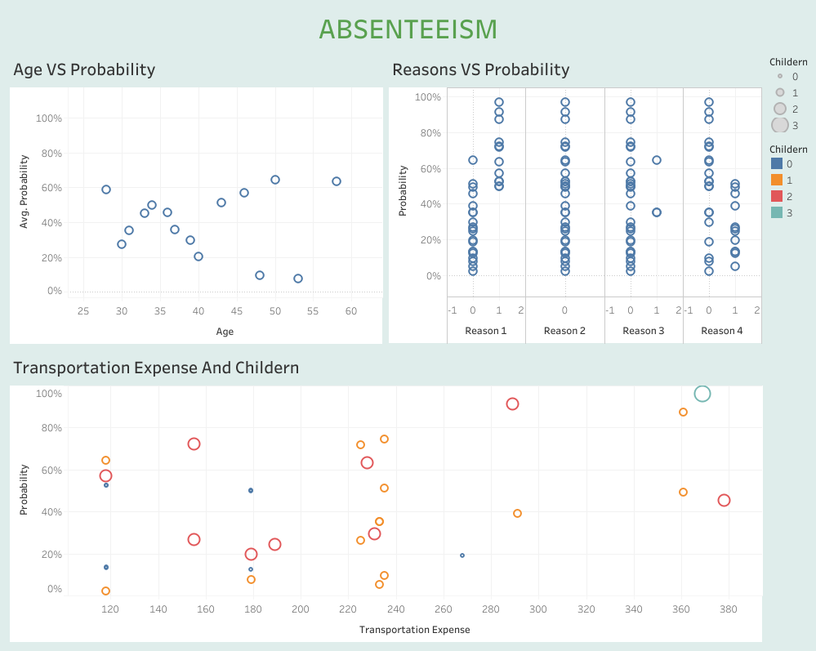

Slide 11
INSIGHTS
Younger people are getting more absent
Reason 1 people are expected to absent more (major diseases)
Employee with more childerns are expected to be absent more

